Slide 1


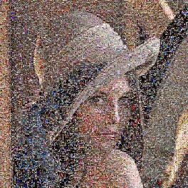



Pattern Recognition and Machine Learning Linear Regression Simone Calderara
Dipartimento di Ingegneria «Enzo Ferrari»,
Università di Modena e Reggio Emilia

Slide 2
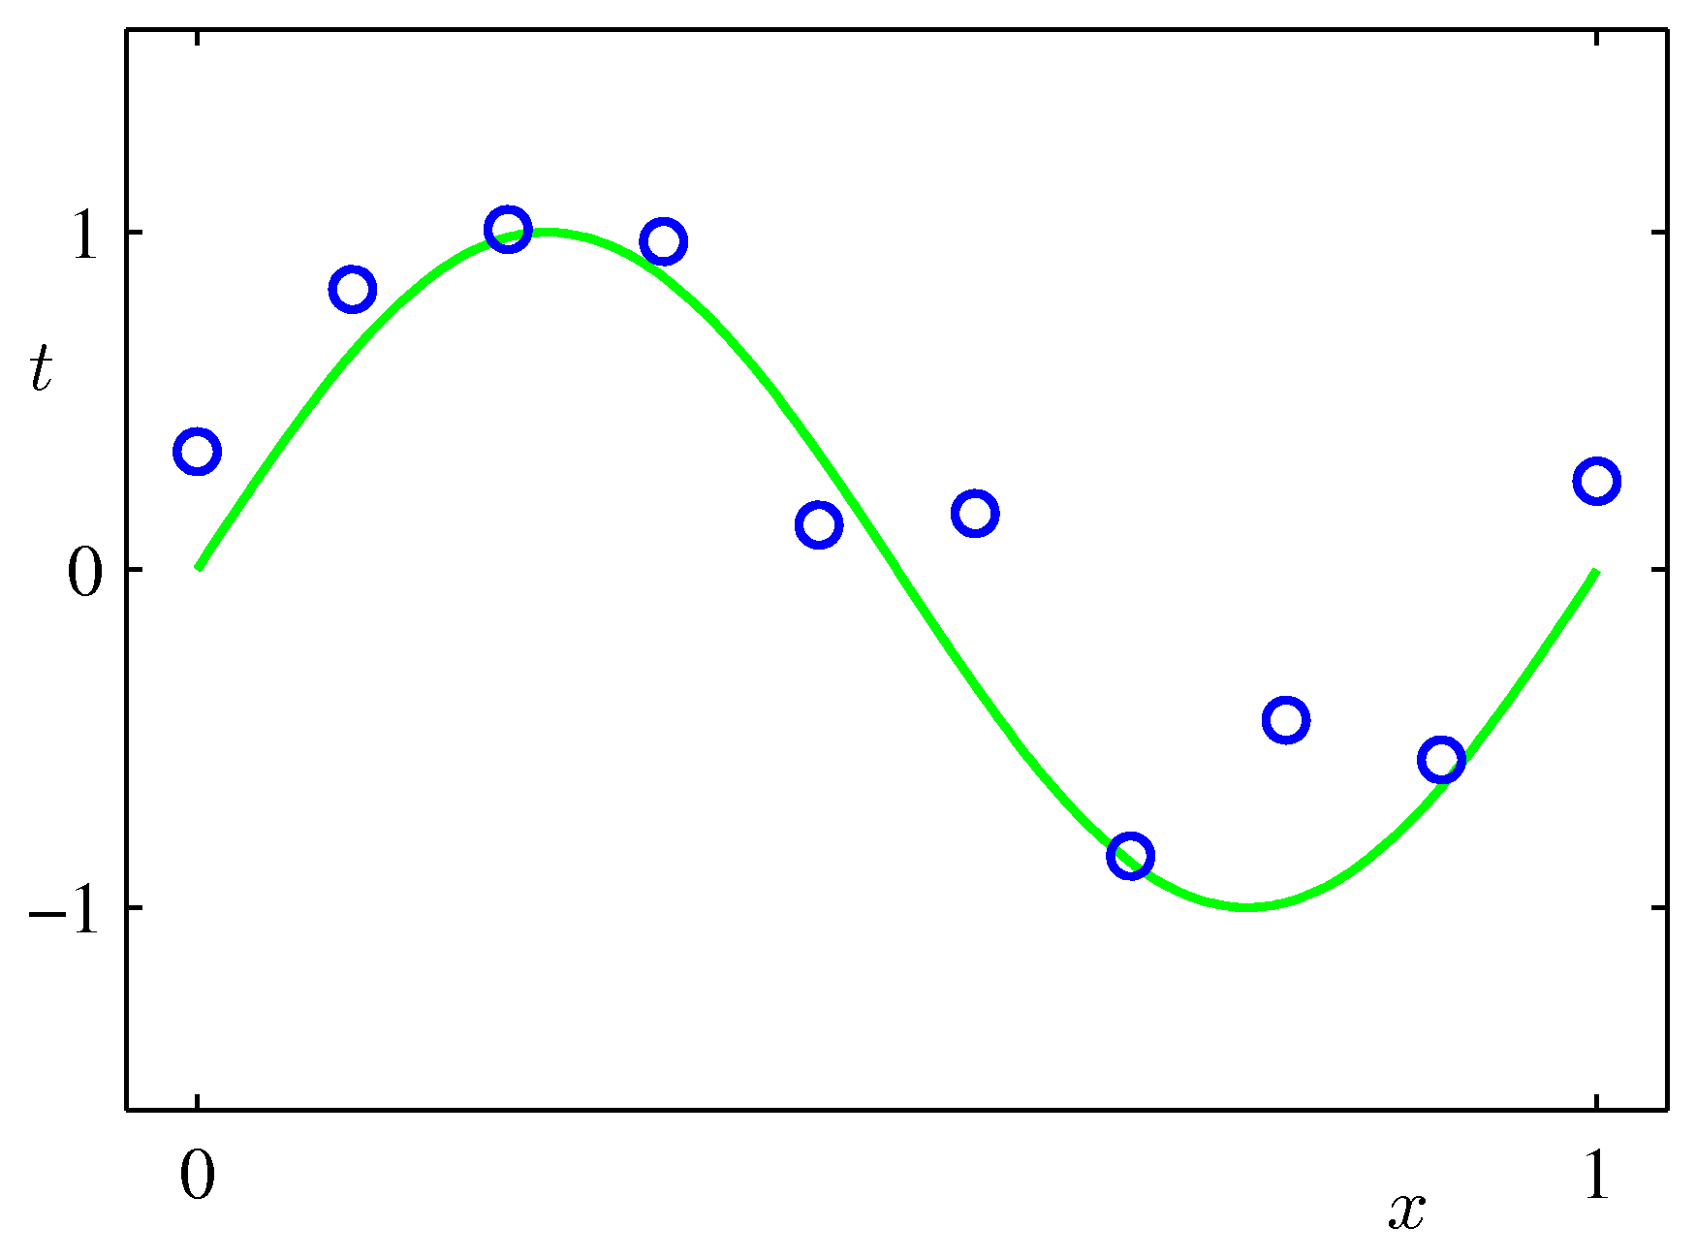
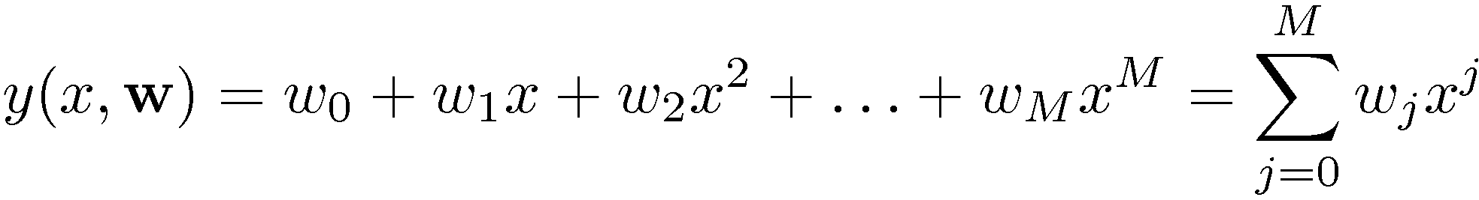
Linear Basis Function Models (1)
Example: Polynomial Curve Fitting

Slide 3
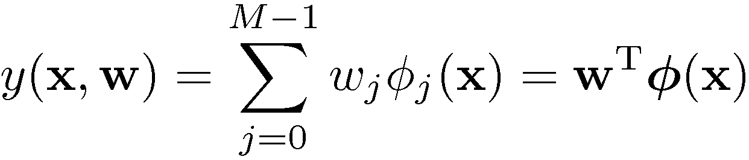
Linear Basis Function Models (2)
Generally
where ϕ_{j} are known as basis functions.
Typically, ϕ, so that w acts as a bias.
In the simplest case, we use linear basis functions : ϕ_{d}=x_{d}.

Slide 4
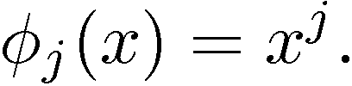
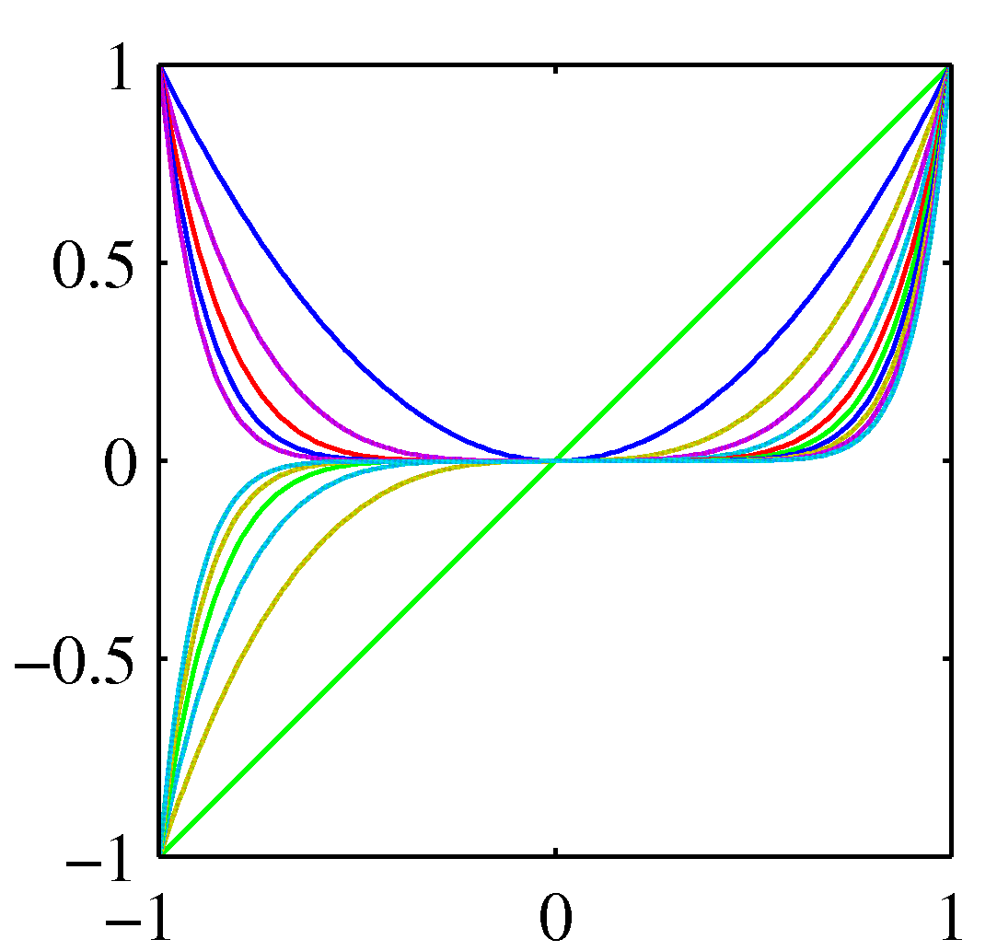
Linear Basis Function Models (3)
Polynomial basis functions:
These are global; a small change in x affect all basis functions.

Slide 5
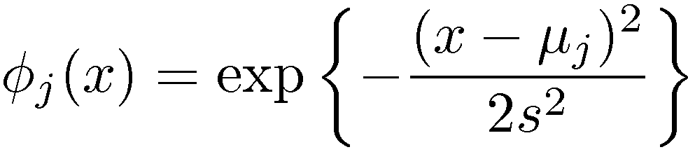
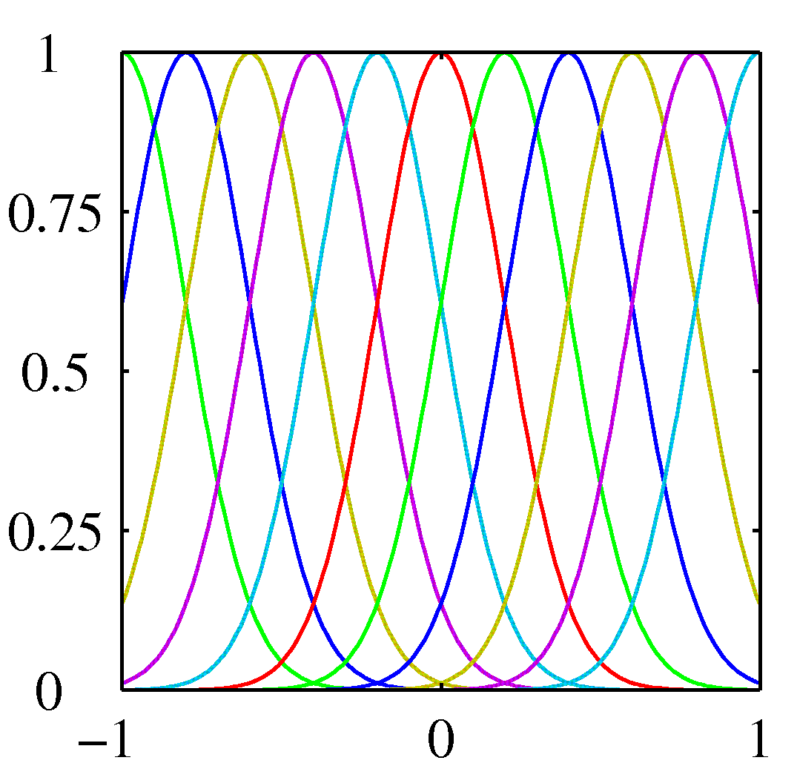
Linear Basis Function Models (4)
Gaussian basis functions:
These are local; a small change in x only affect nearby basis functions. ϕ_{j} and s control location and scale (width).

Slide 6
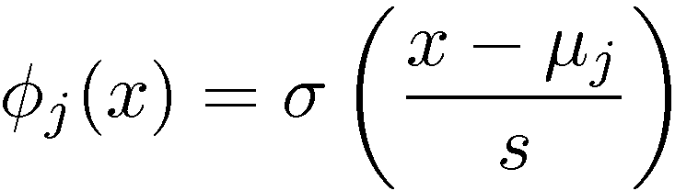
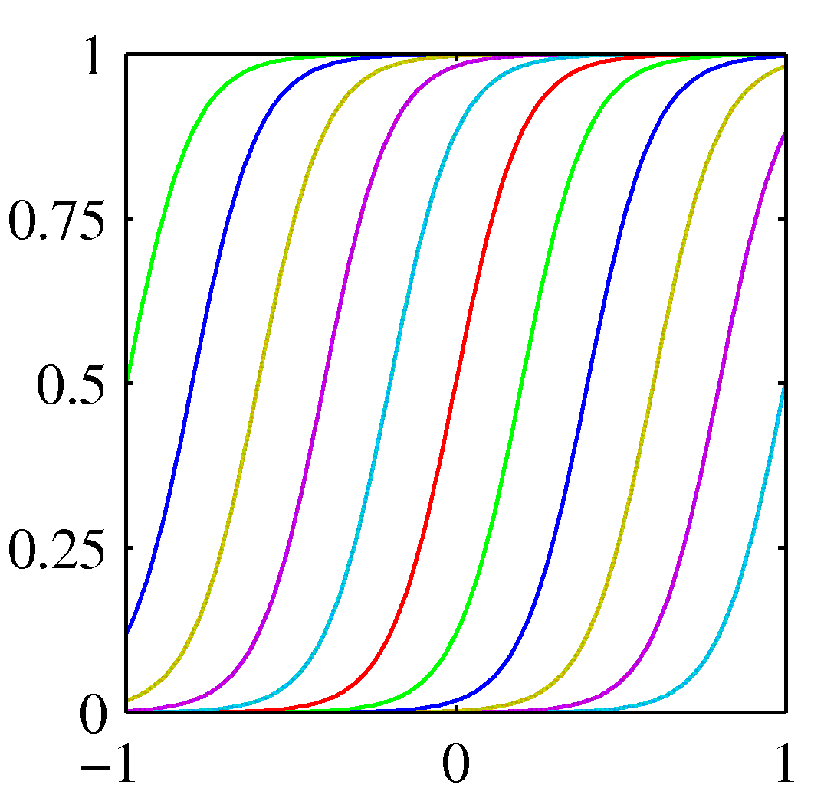
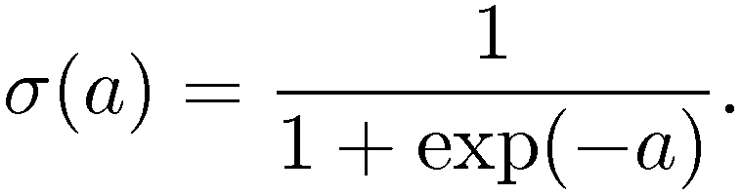
Linear Basis Function Models (5)
Sigmoidal basis functions:
where
Also these are local; a small change in x only affect nearby basis functions. µ_{j} and s control location and scale (slope).

Slide 7

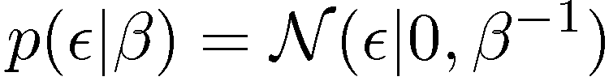

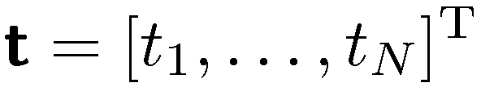
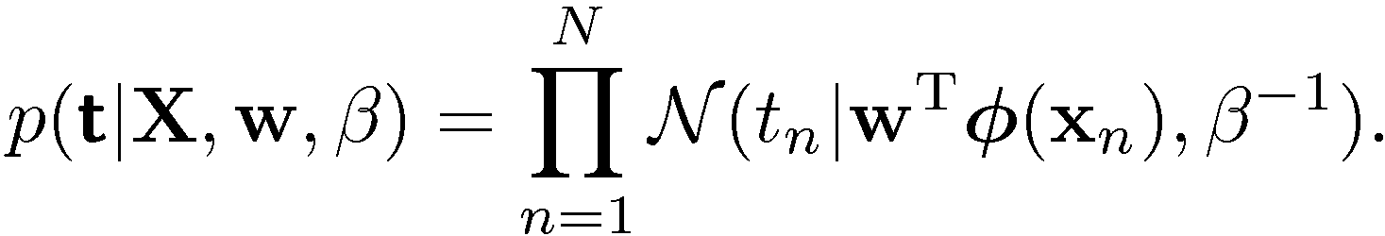
Maximum Likelihood and Least Squares (1)
Assume observations from a deterministic function with added Gaussian noise:
which is the same as saying,
Given observed inputs, , and targets
The individual sample likelyhood is
we obtain the likelihood function on the dataset
where

Slide 8
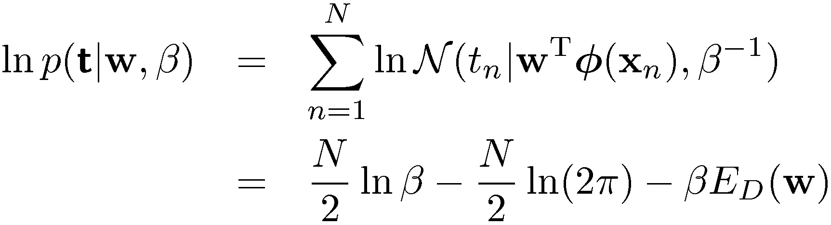
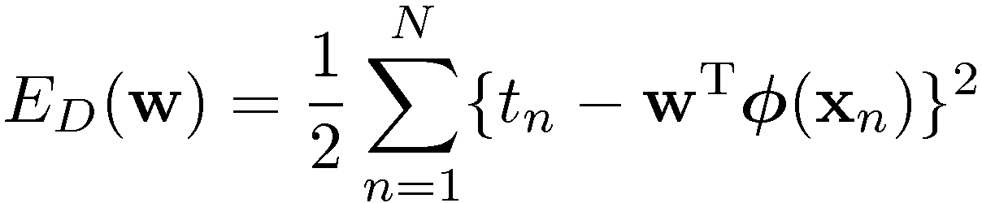
Maximum Likelihood and Least Squares (2)
Taking the logarithm, we get
where
is the sum-of-squares error.

Slide 9
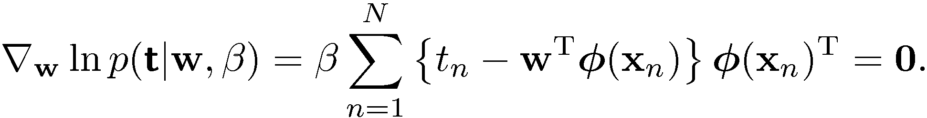


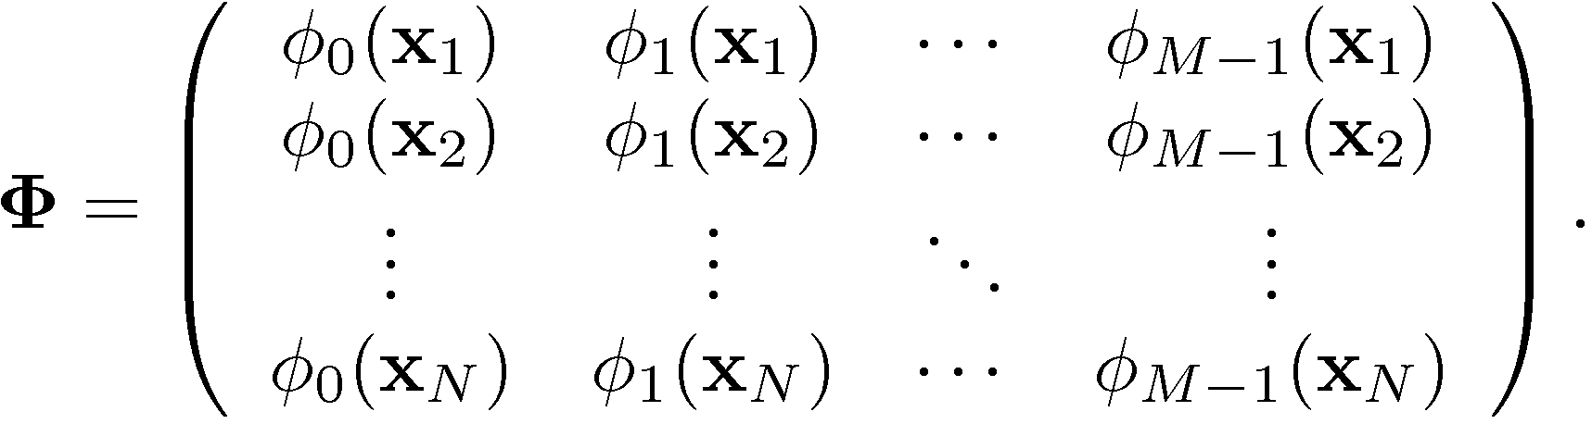
Maximum Likelihood and Least Squares (3)
Computing the gradient and setting it to zero yields
Solving for w, we get
where
The Moore-Penrose pseudo-inverse, .

Slide 10
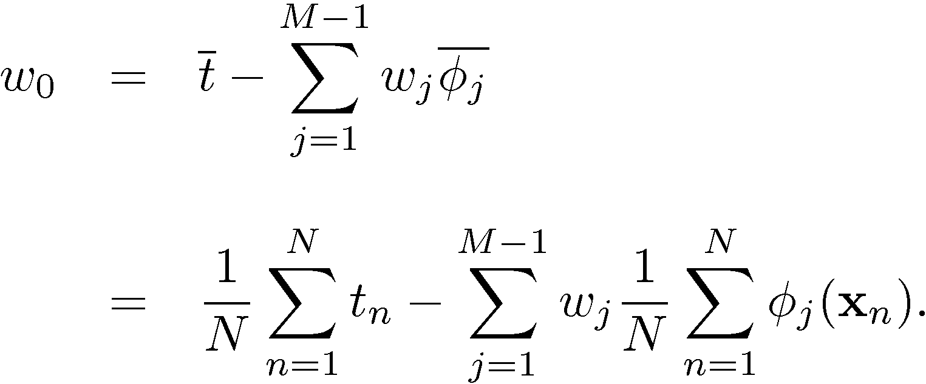
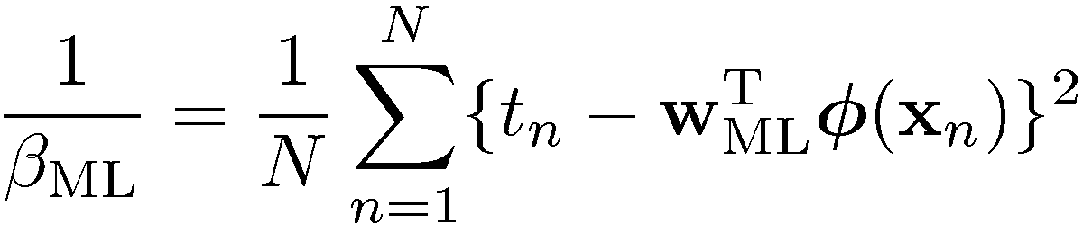

Maximum Likelihood and Least Squares (4)
Maximizing with respect to the bias, w₀, alone, we see that
We can also maximize with respect to $\overline{φ}$, giving

Slide 11
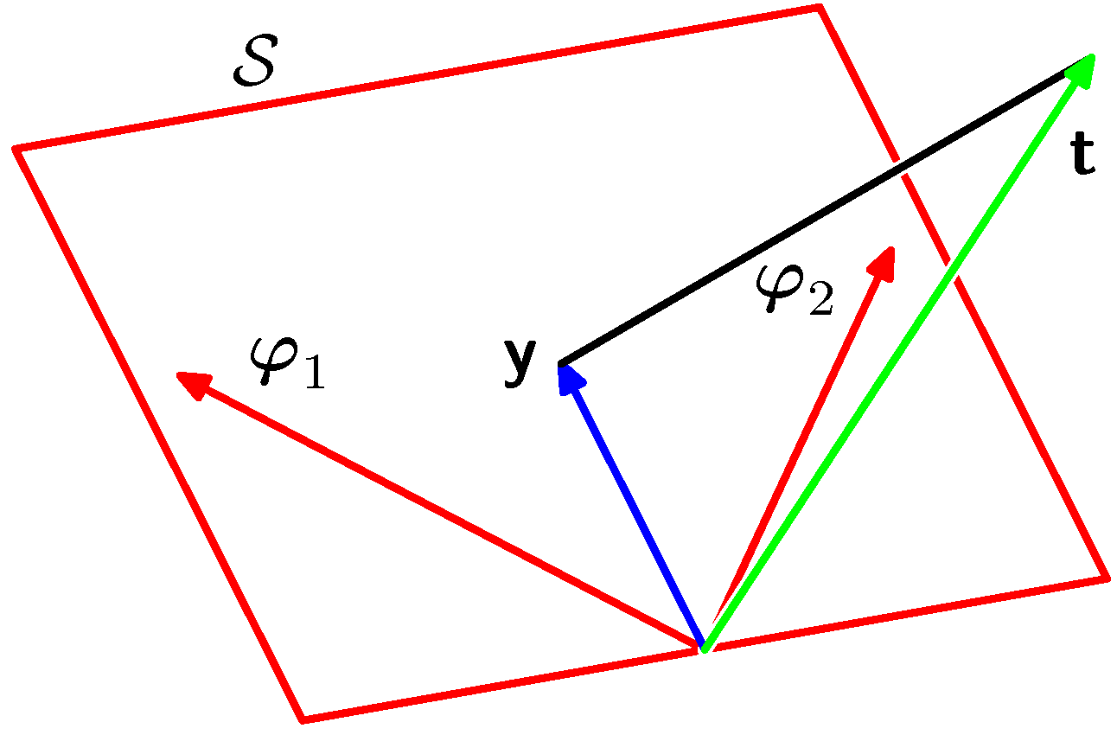


Geometry of Least Squares
Consider
S is spanned by .
w_{ML} minimizes the distance between t and its orthogonal projection on S, i.e. y.
N-dimensional
M-dimensional

Slide 12
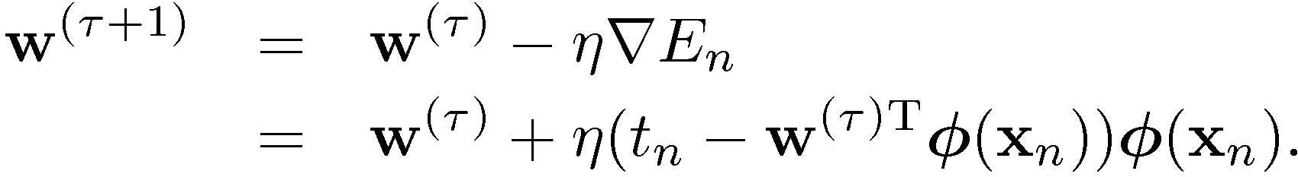
Sequential Learning
Data items considered one at a time (a.k.a. online learning)
use stochastic (sequential) gradient descent:
Take one point at a time and iterate
Reacall
This is known as the least-mean-squares (LMS) algorithm.

Slide 13

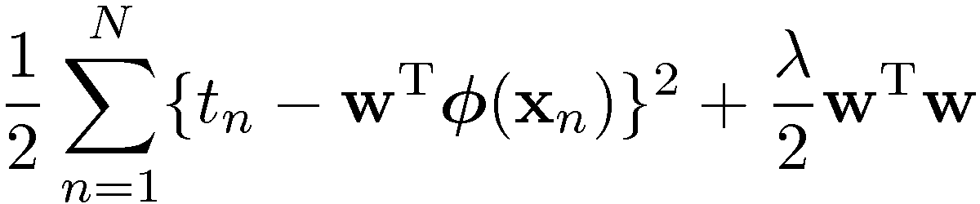
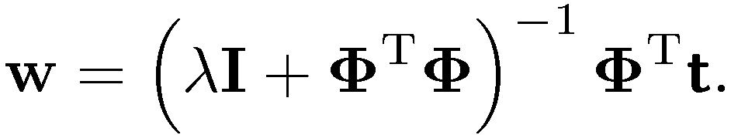
Regularized Least Squares (1)
Consider the error function:
With the sum-of-squares error function and a quadratic regularizer, we get
which is minimized by
Regularization:
Number of training Samples not large enough compared to the features number
Overfitting Occurs
This is due to large weight values in w
Data term + Regularization term
λ¸ is called the regularization coefficient.

Slide 14
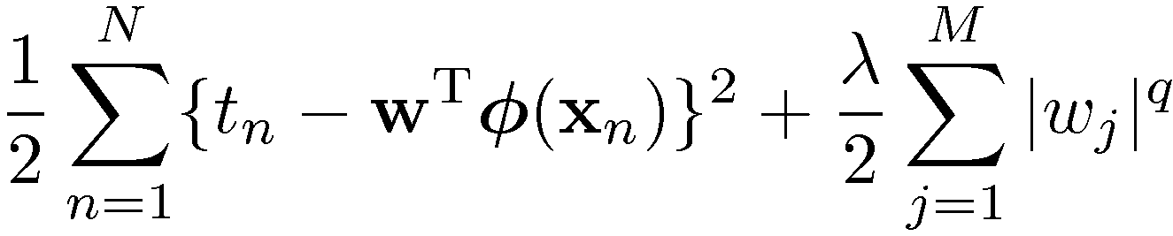
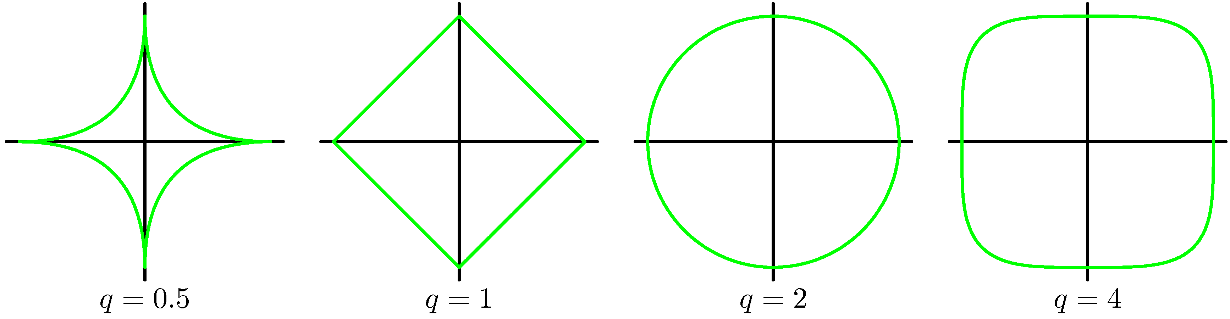
Regularized Least Squares (2)
With a more general regularizer, we have
Lasso
Quadratic

Slide 15
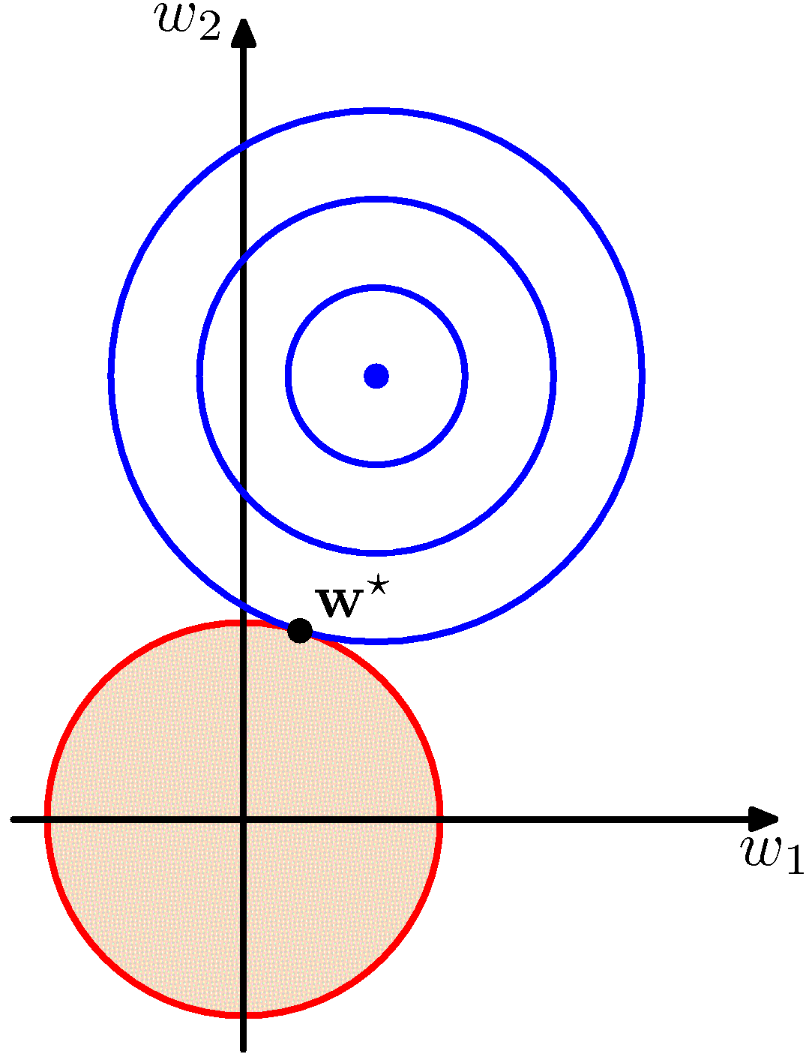
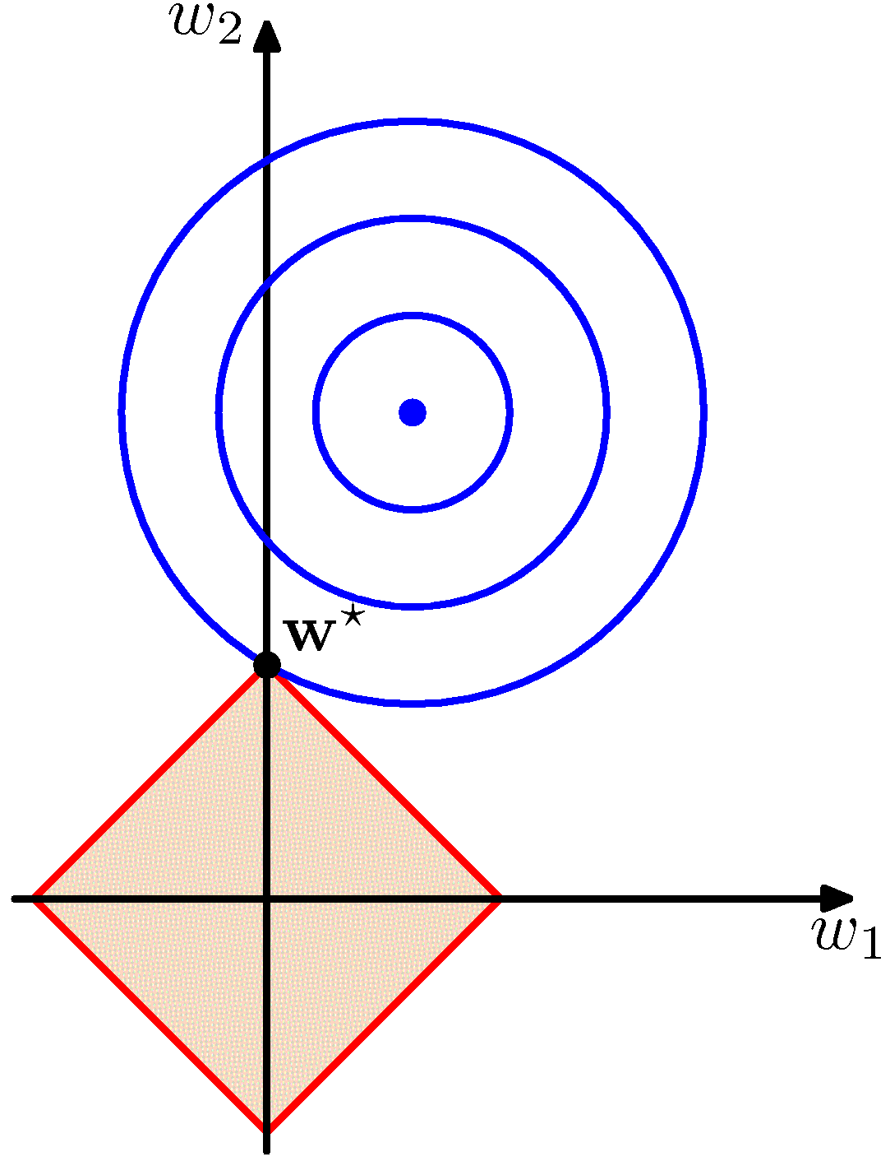
Regularized Least Squares (3)
Lasso tends to generate sparser solutions than a quadratic regularizer.

Slide 16
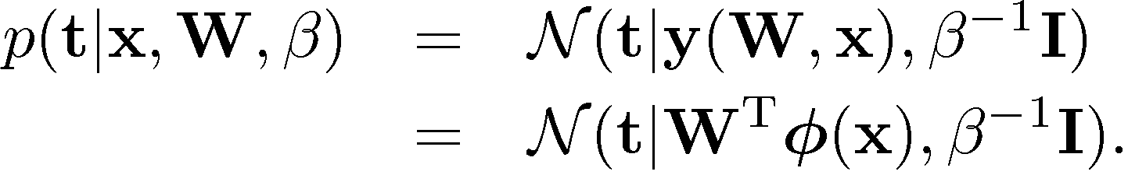
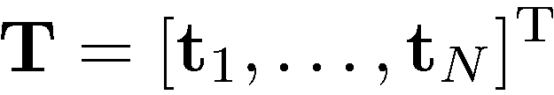
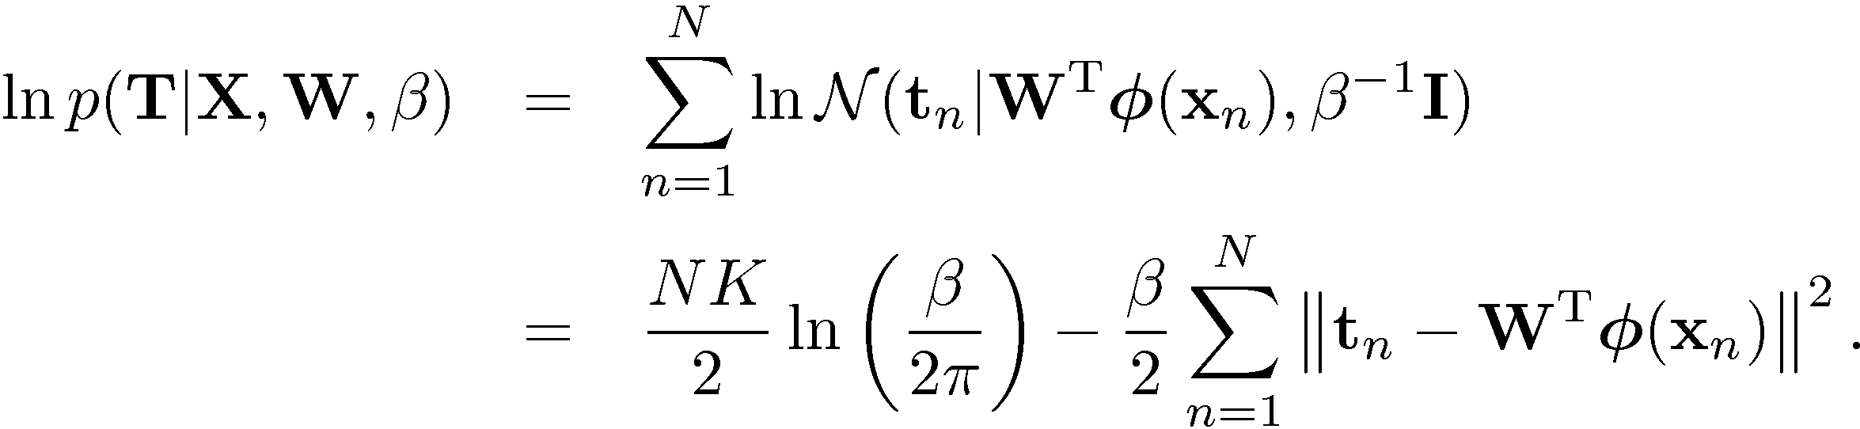
Multiple Outputs (1)
Analogously to the single output case we have:
Given observed inputs, , and targets, , we obtain the log likelihood function

Slide 17

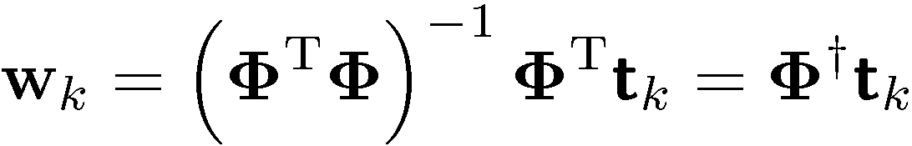
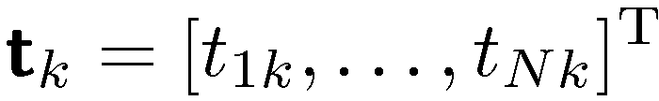
Multiple Outputs (2)
Maximizing with respect to W, we obtain
If we consider a single target variable, t_{k}, we see that
where , which is identical with the single output case.

Slide 18
Limitations of Fixed Basis Functions
M basis function along each dimension of a D-dimensional input space requires M^{D} basis functions: the curse of dimensionality.

